Slide 1

Diploma 17 stream
Gozhin Ilia
https://github.com/ilya2203/Diploma_Ilia_G_17_Infra https://github.com/ilya2203/Diploma_Ilia_G_17

Slide 2
Task description:
To attract hockey fans to the marketing campaign you will need to analyze the statistics of the finished season and make a top 10 list of Sweden players who scored the maximum number of goals in games in Canada. Use https://gitlab.com/dword4/nhlapi API, all required data must be stored in a local database.

Slide 3






Infrastructure:
Kubernetes
Container registry
Storage account
Frontend(python, flask)
&Backend(python)
Postgres Flexible Server

Slide 4





CI&CD Infrastructure process:
Artifacts
Storage
Postgres DB
Azure Registry
Code
Main.tf
TF State File
AKS
VCS
CI
CD

Slide 5


CI&CD Application process:
Public registry
Postgres DB
Code
Docker image
Private registry
App pod
Load balancer
AKS
Dev
VCS
Docker image
Docker image
App pod
CI
CD
Prod

Slide 6
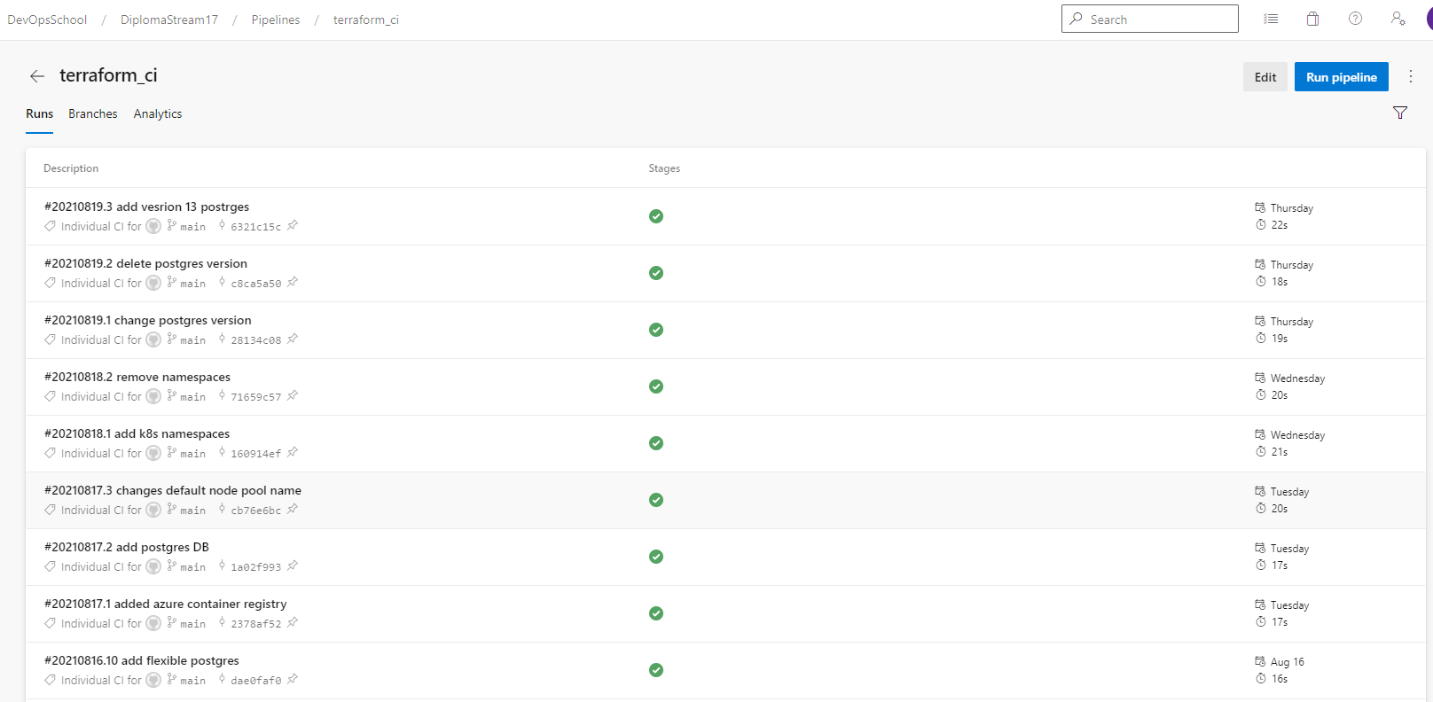
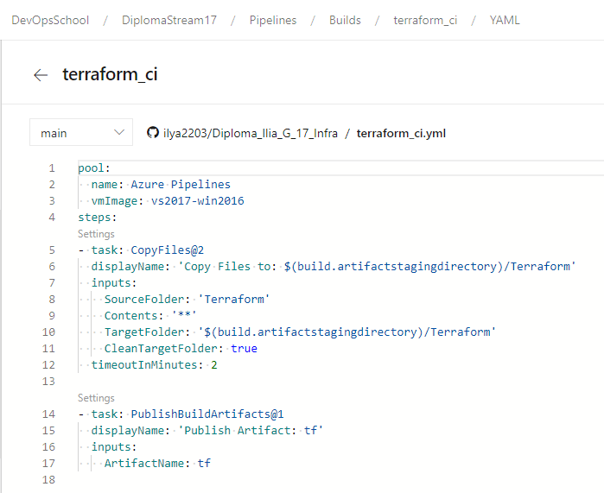
Infrastructure CI deployment:
Preparing IaC: https://github.com/ilya2203/Diploma_Ilia_G_17_Infra.
Create Azure DevOps Pipeline for IaC.

Slide 7
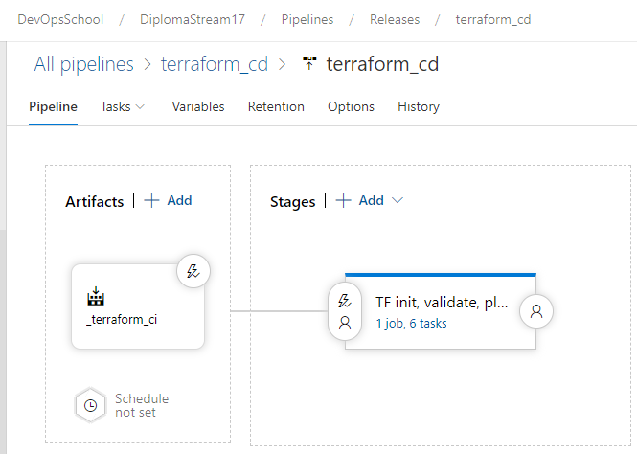
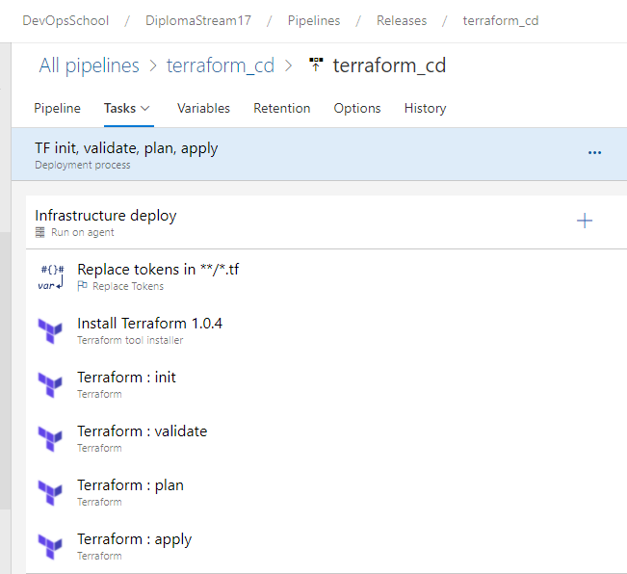
Infrastructure CD deployment:
Use Azure DevOps release for creating deployment
Create Azure DevOps Pipeline for IaC.
On pipelines change variables in main.tf files from library and publish artifact.

Slide 8
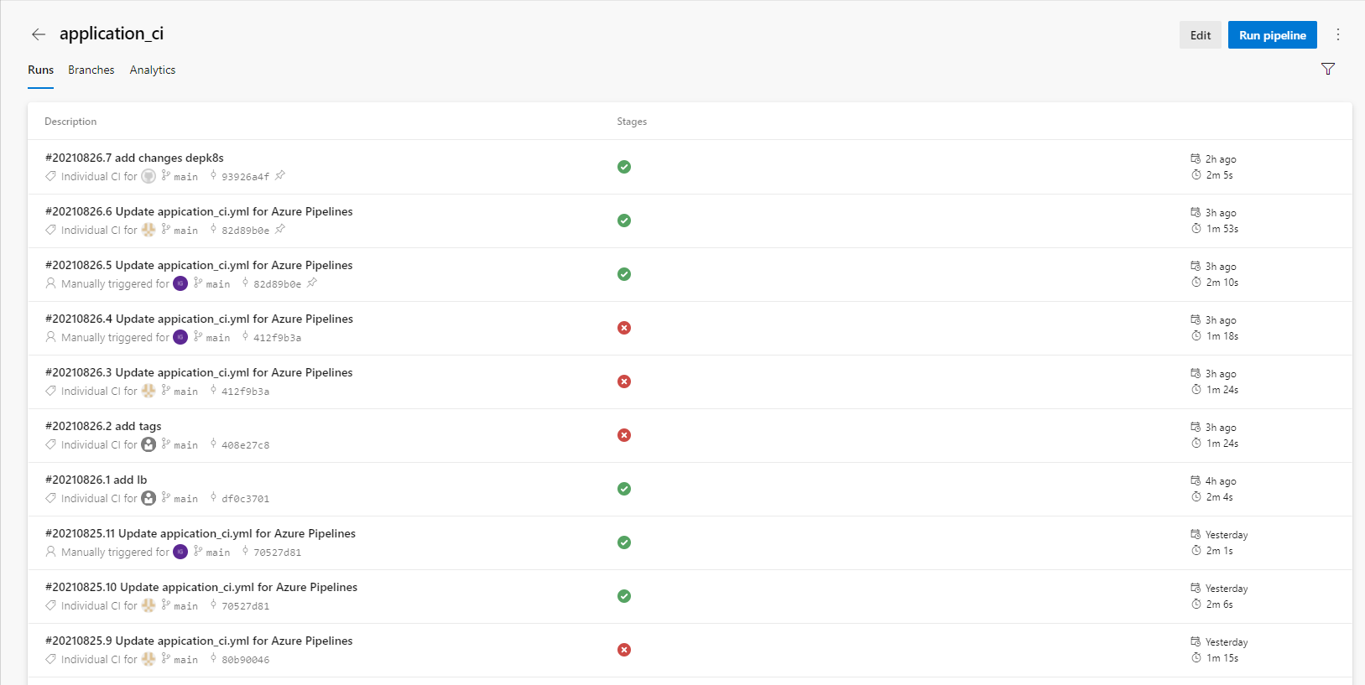
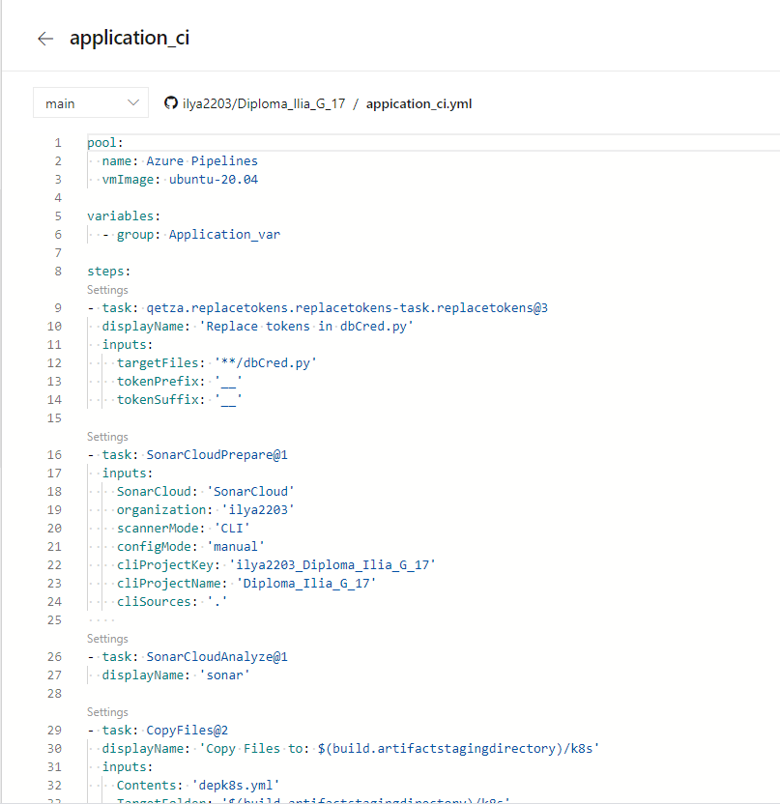
Application CI deployment:
Preparing IaC: https://github.com/ilya2203/Diploma_Ilia_G_17.
Create Azure DevOps Pipeline for Application.

Slide 9
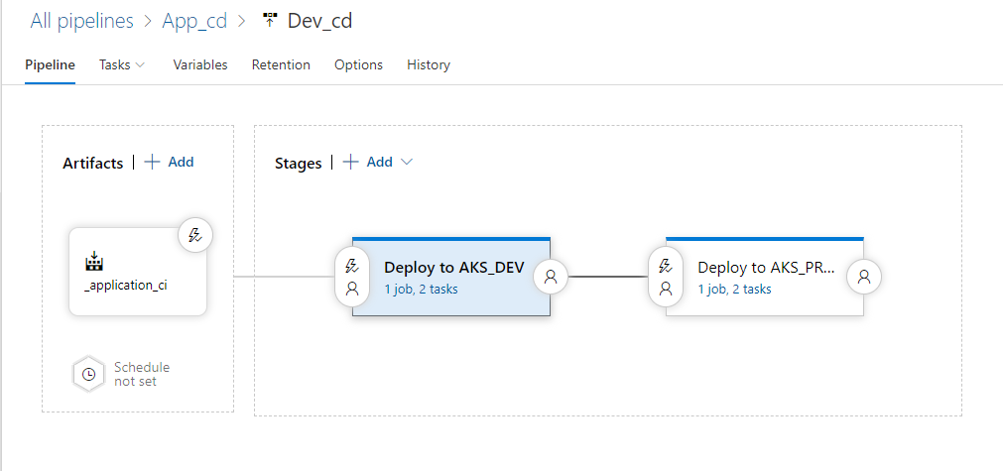
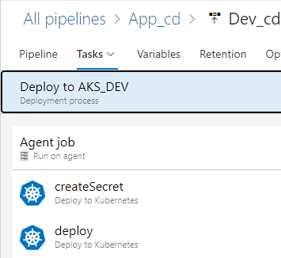
Appication CD deployment:
Use Azure DevOps release for creating deployment
Create Azure DevOps Pipeline for Application.

Slide 10
Спасибо за Внимание !!!

